Slide 1
Marketing Campaign Analysis:
Department Store

Slide 2
Hypothesis
Creemos posible entrenar un algoritmo que ofrezca mas de un 70 % de acierto sobre los datos de campañas de marketing de una gran superficie
It´s posible to train a model that offers over 80% success in predictions over department store´s marketing campaign data

Slide 3
Process infographic
Step 1
Data Wrangling
Step 2
Data Cleaning
Step 3
Data Visualization
Step 4
Data Preprocessing
Step 5
Machine Learning
Step 6
API (Server)

Slide 4
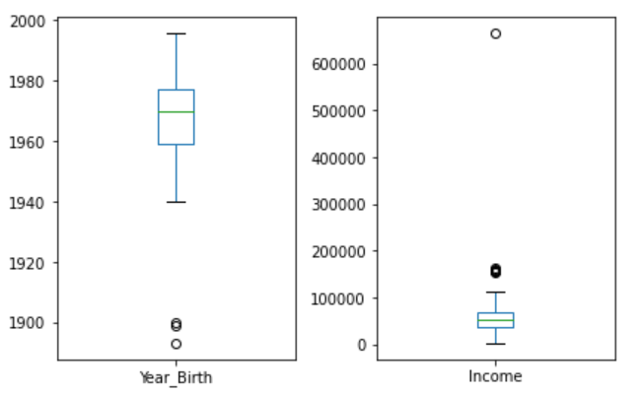
Step 2
Data Cleaning
Dropped unnecessary columns
Dropped rows with inefficient data
Adding new columna to existing dataframe
Renaming columns
Transform string (currency) column to numeric (float)
Filled NAN values with the mean value of the column
Checked for outliers

Slide 5
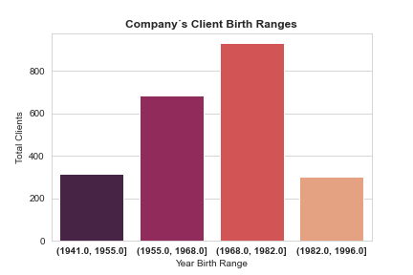
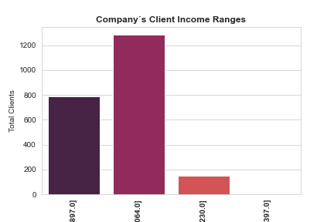
Step 3
Data Visualization

Slide 6
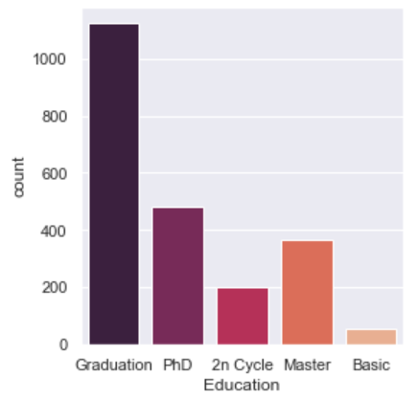
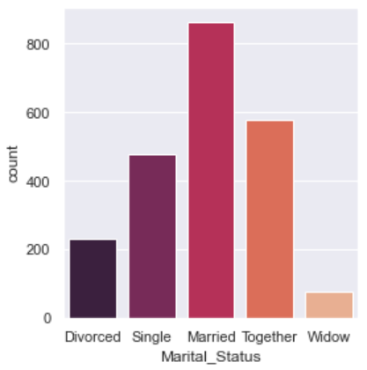
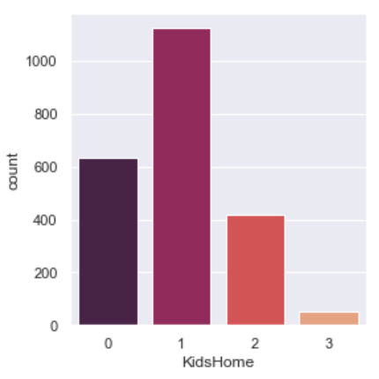
Step 3
Data Visualization

Slide 7
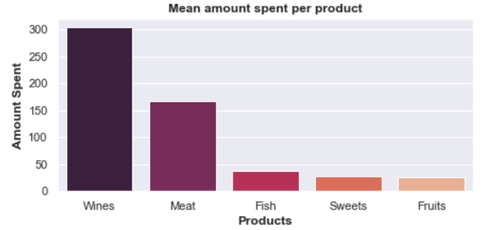
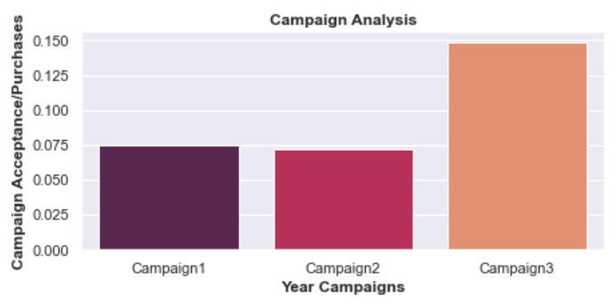
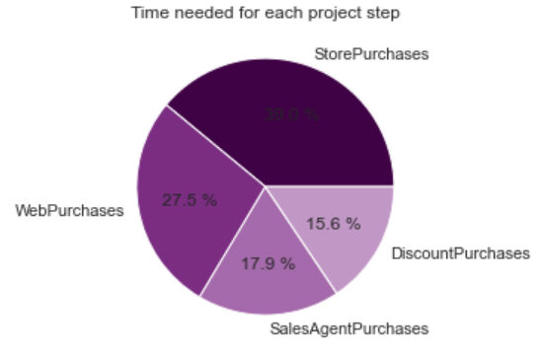
Step 3
Data Visualization

Slide 8
Step 4
Data Preprocessing
Encoding columns: “Education” and “Marital_Status” with Get_Dummies
Preparing input and target values:
X = Input data
Y = Target (Campaign 3)
Split data into train and test

Slide 9
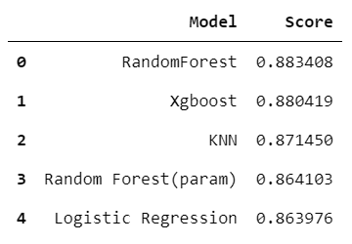
Step 5
Machine Learning
The objective of this Project is to predict if a campaign Will be accepted (purchase Will be made) by a customer.
Machine Learning algorithms used: CLASSIFICATION MODELS.
All models trained were trained with default parameters and with GridSearch (seperately)
Algorithms used:
Logistic Regression
SVC
Random Forest Classifier
KNN
XGBoost

Slide 10
Step 6
API Server
Saved the model with the best score (RandomForest)
Created arrays for each class in columns where get dummies was previously done
Transformed these arrays into jsons
Imported jsons in my server
Step 1
Step 2
Step 3
Step 4
Pass this data to my model and show prediction
Created Html file where you can introduce customer data to predict if they will accept campaign 3
Step 6
Step 5

Slide 11
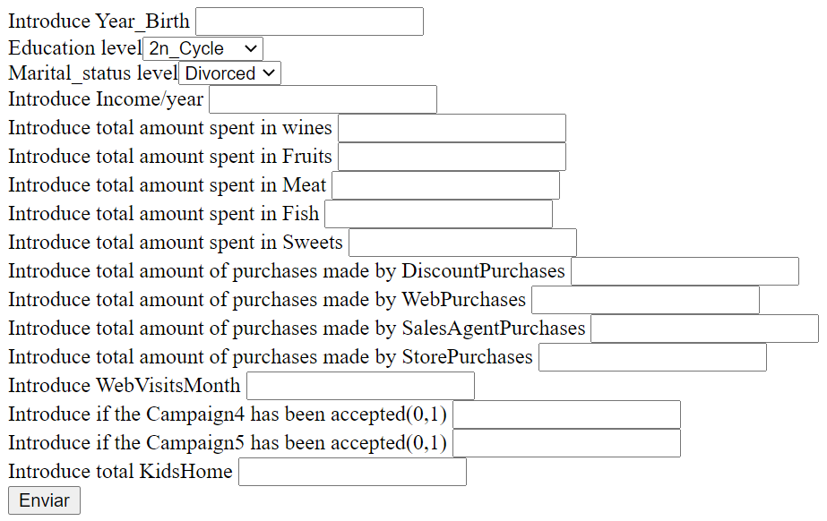

Slide 12
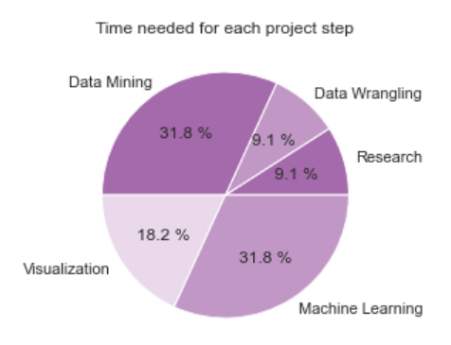
Project timings

Slide 13



Thank You!
kdadlani85@gmail.com
/kapil-dadlani-mirpuri
@KapilDM

